Slide 1
Data Driven Strategies: Opportunities and Challenges for Multi-Disciplinary Partnerships
Moderator: John Markovic, Senior Social Science Analyst, Office of Community Oriented Policing Services (COPS), U.S. Department of Justice
Presenters:
Dennis Culhane, Dana and Andrew Stone Chair in Social Policy, University of Pennsylvania
Edmund McGarrell, Director, School of Criminal Justice,
Michigan State University
Iliana Peters, Health Information Privacy Specialist,
Office for Civil Rights, Department of Health and Human Services

Slide 2
Increase Flow, Meaning, and Engagement in Making Decisions, Policies, and Strategies
Not just about exchanging data But about informed partnerships communicating in context and relying on data-driven strategies
Around a Defined Problem

Slide 3
Increase flow, meaning, and engagement.....around “units of analysis”
Persons at Risk

Slide 4
Increase flow, meaning,
and engagement.....around
“units of analysis”
Families at Risk

Slide 5
Increase flow, meaning,
and engagement.....around
“units of analysis”
Groups at Risk

Slide 6
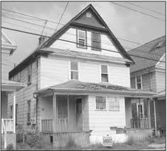
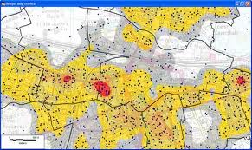
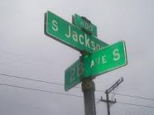
Increase flow, meaning,
and engagement.....around
“units of analysis”
Risky Places

Slide 7
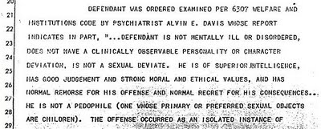
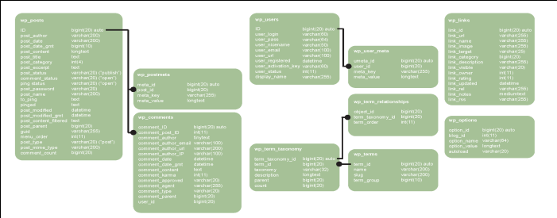
Increase Flow, Meaning,
and Engagement.....around
Reports
(Case Reviews, Statistical Summaries, Annual Reports)
Structured Data
Informal Communication &
Partnership Building
Around a Defined Problem

Slide 8
Balanced Approach
Persons at Risk
Families at Risk
Persons at Risk
Families at Risk
Individual Risk Assessment Tools
Psycho-emotional Issues
School performance Issues
Involvement in School Disciplinary
System
Chronic Truancy/Tardiness
Drug Endangered Children (DEC)
Families Referred for Child Abuse and
Neglect (CANS)
Children of Institutionalized Parents
Homeless Families
Intergenerational Gangs
Groups at Risk
Risky Places
Groups at Risk
Risky Places
Gang/Cliques
“Wannabes”
Levels of Affiliation
Other “Anti-Social Youth Groups
Taggers
Stoners
Hotspots (geographic)
Crime-Attractors and Generators
Substandard Schools
Businesses
Public Places
Gang Territories
Notes:
Persons at Risk
Individual Risk Assessment Tools
Psycho-emotional Issues
School performance Issues
Involvement in School Disciplinary
System
Chronic Truancy/Tardiness
Groups at Risk
Gang/Cliques
“Wannabes”
Levels of Affiliation
Other “Anti-Social Youth Groups
Taggers
Stoners
Families at Risk
Drug Endangered Children (DEC)
Families Referred for Child Abuse and
Neglect (CANS)
Children of Institutionalized Parents
Homeless Families
Intergenerational Gangs
Risky Places
Hotspots (geographic)
Crime-Attractors and Generators
Substandard Schools
Businesses
Public Places
Gang Territories

Slide 9
Core Elements of Balanced Data-Driven Approaches
Partners/Stakeholders Engagement
Data Collection with Close Attention to Data Quality
Data Analysis and Collaboration
Evidence-Based Strategies and Operations
Information Sharing on a Continuous Basis
Monitoring, Evaluation, and Adjustments
Assessing Outcomes, Not Just Outputs
Compliance with Data Confidentiality, Privacy, and Security

